Slide 1
Predicting Length of Stay in Hospital (LOSH)
Muhammad Usama Saleem

Slide 2
INTRODUCTION
Objective/Problem Statement: Accurately predict LOSH and identify significant impact factors using Machine Learning Algorithms.
LOSH prediction is crucial for hospital management and patient care.

Slide 3
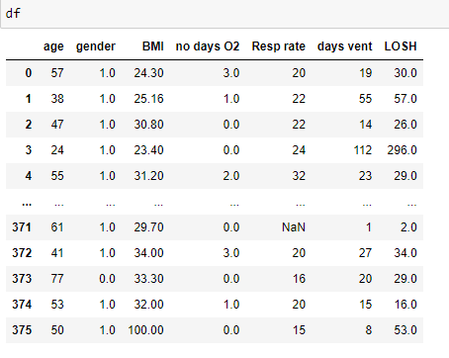
Dataset Overview
Dataset: Data is collected in hospital contains patient different characteristics and hospital stay information.
Features: age, gender, BMI, days on oxygen, respiratory rate, days on a ventilator,
Target Variable: LOSH.

Slide 4
Approach Overview
Data Preprocessing
EDA
Model Building
Model Evaluation

Slide 5
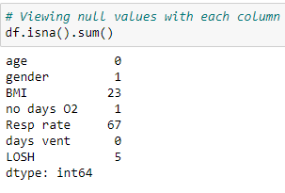
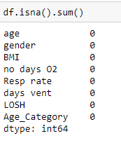
Data preprocessing
Cleaning the dataset.
Handling missing values.
Ensuring the data is in a suitable format for analysis.

Slide 6
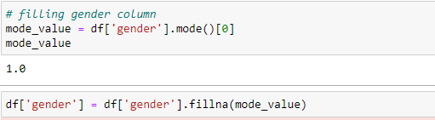
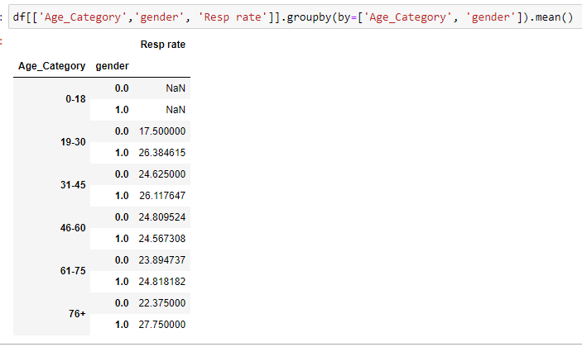

Slide 7
Exploratory Data Analysis (EDA)
Explore the dataset to gain insights into the relationships between different features and LOSH.
Identify potential correlations and patterns.
NOTE: The feature with the highest correlation or strongest correlation is “days on a ventilator”, as shown in the upcoming slides through a correlation matrix.

Slide 8
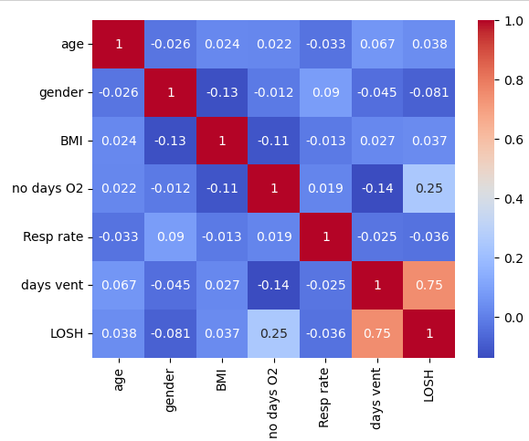

Slide 9
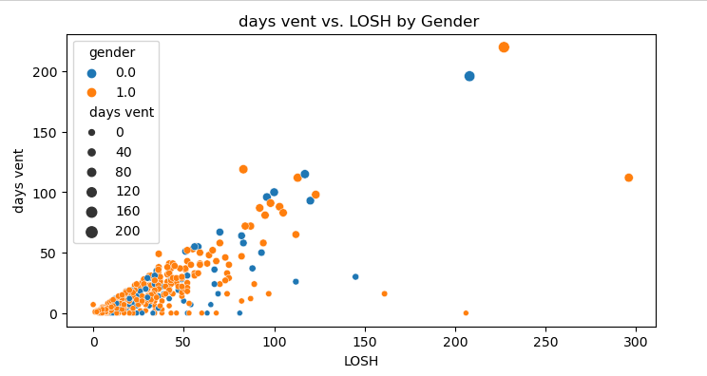

Slide 10
Model Building
Split Data into test and train sets, trained data on 80% and test data 20%
Build several regression models including Linear Regression, SVR, K-Nearest Neighbors, and Random Forest Regressor.
Models to predict Length of Stay in Hospital (LOSH).

Slide 11
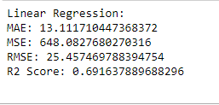
Model Evaluation
Evaluated models using MAE, MSE, RMSE, R2 score.
Metrics to measure accuracy and performance.

Slide 12
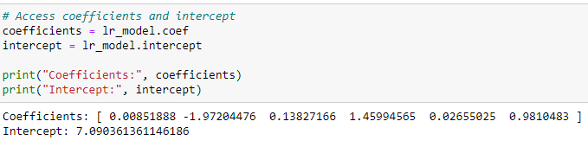
The Coefficients and Intercept accessed through Linear Regression Model

Slide 13
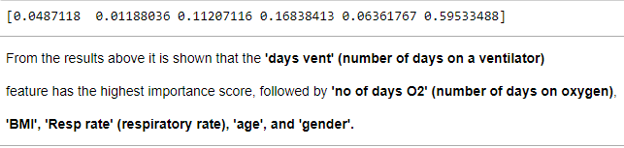
Feature Importance Analysis
For the best-performing model ,analyze feature importance scores to identify which factors have the most significant impact on predicting LOSH.

Slide 14
Conclusion
In conclusion, through the analysis, I have developed predictive models for predicting Length of Stay in Hospital (LOSH). By evaluating the model's performance metrics and assessing feature importance, I have gained valuable insights into the factors that significantly influence LOSH. Notably, I have identified that 'days on vent' (number of days on a ventilator) emerges as the most impactful factor affecting LOSH.
Interestingly, it's worth noting that despite employing different machine learning algorithms, I have observed remarkable consistency in the Mean Absolute Error (MAE), Mean Squared Error (MSE), Root Mean Squared Error (RMSE), and R2 score across all models.

Slide 15
THANK YOU

